Slide 1
Explainable NLP: A Systematic Survey
Hadi Mohammadi, Ayoub Bagheri, Anastasia Giachanou
And Daniel Oberski
Keywords density visualization in VOSviewer

Slide 2
Systematic Survey
Source: IEEE Xplore, ACL ACM Digital Library, Scholar and Scopus
Search Methodology: explainable AI + natural language processing in the {title, abstract, and keywords}
Time Interval:
2010-2023
Bibliographic analysis tools: VOSviewer¹ + Scopus Analysis
Result: 217 related papers+ 130 Connections between Articles
Cleaning and achieving 135 paper
1- https://www.vosviewer.com/

Slide 3
Systematic Survey
Network visualization. in VOSviewer

Slide 4
Systematic Survey
The number of articles by year and their source based on Scopus analysis

Slide 5

Introduction
Background and Importance of Explainable NLP
NLP models have permeated numerous sectors
Scope and Objectives of the Review
Review of diverse modeling methodologies for crafting explainable NLP models
Methodology and Organization of the Review
Exhaustive exploration and critical analysis of recent research papers, articles, and proceedings
'Black box' models pose challenges to comprehensibility
Explainable NLP aims to imbue transparency and interpretability
Explainable NLP reconciles the trade-off between model sophistication and human understanding
Explainable NLP touches upon ethical, legal, and societal implications
Exploration of applications of explainable NLP
Consideration of evaluation methodologies for explainability in NLP
Addressing challenges faced in the realm of explainable NLP
Highlighting prospective research avenues in this domain
Review unfolds across five primary sections
Each section dedicated to a different facet of explainable NLP
Notes:
Background and Importance of Explainable NLP:
NLP models have permeated numerous sectors, demonstrating an extraordinary capacity for understanding, processing, and generating language.
'Black box' models pose challenges to comprehensibility, precipitating concerns about accountability, trustworthiness, and the risk of fostering biased or discriminatory outcomes.
Explainable NLP aims to imbue transparency and interpretability into the labyrinthine mechanics of NLP models.
Explainable NLP reconciles the trade-off between model sophistication and human understanding.
Explainable NLP touches upon ethical, legal, and societal implications, underlining the importance of securing responsible and accountable AI systems.
Scope and Objectives of the Review:
The review will include a diverse range of modeling methodologies for crafting explainable NLP models.
It will explore the vast array of applications of explainable NLP.
It will consider the diverse range of evaluation methodologies for explainability in NLP.
It will address the challenges faced in the realm of explainable NLP.
It will highlight prospective research avenues in this domain.
Methodology and Organization of the Review:
The methodology involves an exhaustive exploration and critical analysis of recent research papers, articles, and proceedings.
The review unfolds across five primary sections.
Each section is dedicated to a different facet of explainable NLP.

Slide 6
Modelling Techniques for Explainable NLP
Modelling Techniques for Explainable NLP
Traditional Explainable Models
Bag of Words (BoW)
Embedding Models
Transformer Models
Bag of Words (BoW)
Weighted Bag of Words
Rationalization Techniques
Extractive Rationalization
Abstractive Rationalization
Word Embeddings
Sentence Embeddings

Slide 7
Bag of Words (BoW)
Bag of Words
Models
Bag of Words (BoW)
Weighted Bag of Words
Explainability Techniques
Visualization of high-dimensional vector spaces
Attention mechanisms in models like BERT
Saliency maps or attention maps
Rationalization Techniques
Struggle with complex and nuanced semantics
Agnostic to syntactic structure and semantic relationships
Notes:
Details of the Model:
Traditional explainable models, such as Bag of Words (BoW) and Weighted Bag of Words, provide clear insights into decision-making processes.
BoW represents text documents as a collection of individual words, disregarding their sequential order or context.
Weighted Bag of Words builds upon BoW by attributing weights to words, reflecting their relative importance in the text, often using Term Frequency-Inverse Document Frequency (TF-IDF).
Explainability Techniques:
BoW and its variants offer clear insights into the model's behavior, with each word's influence on the decision-making process being directly proportional to its frequency.
Visualization of high-dimensional vector spaces in embedding models helps understand relationships between words and the inherent structure of the language.
Attention mechanisms in models like BERT provide insights into which input parts contribute most to the model's decisions.
Saliency maps or attention maps provide incomplete or even misleading interpretations, necessitating ongoing research to develop more reliable and intuitive ways to explain these models.
Challenges:
Traditional models falter when dealing with complex and nuanced semantics of natural languages, such as word sense ambiguity and contextual relationships.
They are agnostic to the syntactic structure and the semantic relationships within a sentence, failing to recognize that the order of words often plays a crucial role in conveying meaning.
Embedding models can be viewed as black boxes due to their complexity.
Techniques to improve their explainability, such as saliency maps or attention maps, can sometimes provide incomplete or even misleading interpretations.
Despite the strides made in the explainability of embedding models, the field continues to grapple with the interpretability-complexity trade-off. As the models become more complex and accurate, their interpretability often diminishes.

Slide 8
Embedding Models
Embedding Models
Models
Word Embeddings (Word2Vec, GloVe)
Sentence Embeddings (Universal Sentence Encoder)
Explainability Techniques
Visualization
Attention Mechanisms
Saliency Maps
Rationalization Techniques
Embedding models viewed as black boxes
Interpretability-complexity trade-off
Notes:
Embedding models have revolutionized the field of NLP by mapping words and sentences into continuous vector spaces, capturing semantic relationships and similarities.
Word embeddings like Word2Vec and GloVe generate dense vector representations for words, with semantically similar words being closer in the vector space.
Sentence embeddings, like the Universal Sentence Encoder, encode entire sentences or paragraphs into fixed-dimensional vectors, capturing the overall semantic content of the text.
Explainability in embedding models is achieved by visualization and identifying influential dimensions in the vector space, with tools like TensorBoard helping to visualize these high-dimensional vector spaces.
Attention mechanisms, as used in models like BERT, provide insights into which input parts contribute most to the model's decisions, enhancing model transparency and interpretability.
Despite their strengths, embedding models can be seen as black boxes due to their complexity, and techniques to improve their explainability can sometimes provide incomplete or misleading interpretations.
Word and sentence embeddings are cornerstone techniques in contemporary NLP, translating raw textual data into numerical representations that encapsulate semantic and syntactic properties of the language.
While word embeddings revolutionized the representation of individual words, they fell short when capturing the semantics of larger text spans, leading to the development of sentence embedding models.
Various explainability techniques have been proposed to combat the opacity introduced by embedding models, including visualization of the embeddings, attention mechanisms, and saliency maps.
Despite progress in the explainability of embedding models, the field continues to grapple with the interpretability-complexity trade-off, with ongoing research aimed at striking the right balance between high performance and satisfying interpretability.

Slide 9
Transformer Models
Transformer Models
Performance
Self-attention mechanisms
Interpretability and Explainability
Visualizing attention weights
Input perturbation techniques
Contextual decomposition
Challenges and Limitations
Significant computational resources
Handling long-term dependencies
Understanding decision-making processes
Complexity
Black box nature
Notes:
Transformer models have challenges and limitations. They require significant computational resources for both training and inference. They are not adept at handling long-term dependencies due to the fixed-length context window. Despite efforts to increase their explainability, understanding Transformer models' decision-making processes remains challenging.

Slide 10
Rationalization Techniques
Rationalization Techniques
Extractive Rationalization
LIME
Current Developments and Applications
Sentiment Analysis
Hate Speech Detection
Challenges and Future Directions
Rationalization Post-Hoc
Standardized Evaluation Metric
Abstractive Rationalization
SEARCH
Grad-CAM
Notes:
Rationalization Techniques: These techniques aim to produce understandable explanations or justifications for model decisions, increasing transparency and interpretability in complex NLP systems.
Extractive Rationalization: This process identifies and extracts the most pertinent segments from the input text that significantly influence the model's decision-making process. Techniques include LIME and Grad-CAM, which generate explanations at the granularity of individual words or phrases.
Abstractive Rationalization: These techniques generate human-readable summaries or explanations of the model's decisions that are not necessarily bound by the original input text. They provide additional context or reasoning that might not be evident from the input alone. However, ensuring that these explanations reflect the model's reasoning is critical.
Current Developments and Applications: The field of rationalization in NLP has seen considerable advancements, with the increased availability of annotated rationales like the e-SNLI dataset. Applications of rationalization techniques include sentiment analysis and hate speech detection.
Challenges and Future Directions: Challenges include the phenomenon of "rationalization post-hoc", where a model might produce plausible-sounding rationales that are not aligned with its actual decision-making process. There is also a need for a standardized evaluation metric for rationales that considers factors like coherence, conciseness, and comprehensibility.

Slide 11
Applications and Domains of Explainable NLP
Overview of different application areas
Medicine
Finance
Systematic Reviews
Customer Relationship Management
Chatbots and Conversational AI
Electronic Health Records
Medical Literature Analysis
Risk Assessment
Fraud Detection
Review Automation
Text Summarization
Sentiment Analysis
Customer Support Automation
Conversational Agents
Context-Aware Recommendations
Case Studies
Medical Diagnosis
Fraud Detection
Systematic Review Automation
Customer Sentiment Analysis
Conversational AI
Study: Choi et al. (2016)
Study: Li et al. (2020)
Study: Marshall et al. (2020)
Study: Liu et al. (2019)
Study: Guidotti et al. (2018)

Slide 12
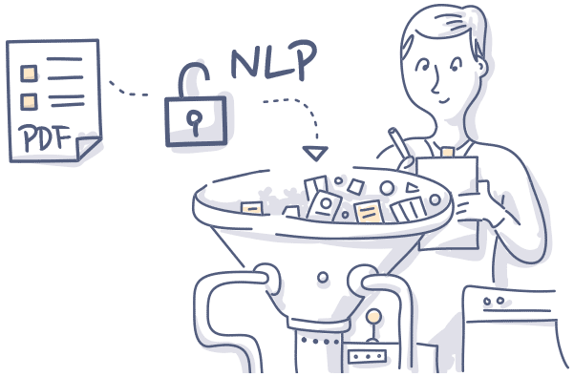
Explainable NLP in Medicine
Explainable NLP in Medicine
Electronic Health Records (EHR)
Extract meaningful insights
Medical Literature Analysis
Analyze medical literature and research papers
Explain diagnoses or treatment recommendations
Deliver clear, understandable explanations of findings or recommendations
https://www.foreseemed.com/natural-language-processing-in-healthcare

Slide 13

Explainable NLP in Finance
Explainable NLP in Finance
Risk Assessment
Provides clear explanations for risk scores or credit assessments
Fraud Detection
Provides insights into features or patterns that triggered fraud alert
Example: Graph-based attention model for credit risk assessment (Wang et al., 2019)
Example: Interpretable machine learning models for financial fraud detection (Varshney & Alemzadeh, 2017)
https://www.johnsnowlabs.com/examining-the-impact-of-nlp-in-financial-services/
Notes:
Explainable NLP in Finance
Risk Assessment
Provides clear explanations for risk scores or credit assessments
Example: Graph-based attention model for credit risk assessment (Wang et al., 2019)
Fraud Detection
Provides insights into features or patterns that triggered fraud alert
Example: Interpretable machine learning models for financial fraud detection (Varshney & Alemzadeh, 2017)

Slide 14

Explainable NLP in Systematic Reviews
Explainable NLP in Systematic Reviews
Review Automation
AI-based tool: RobotAnalyst (Marshall et al., 2016)
Text Summarization
BERT for extractive summarization (Nye et al., 2018)
https://asreview.nl/

Slide 15

Explainable NLP in CRM
Explainable NLP in CRM
Sentiment Analysis
Layer-wise Relevance Propagation (LRP)
Customer Support Automation
Chatbots
Provides clear explanations for sentiment predictions
Incorporating explainability
Explains reasoning behind responses or recommendations
https://www.textunited.com/blog/ai-in-customer-service-the-hidden-world-beyond-chatbots/
Notes:
In summary, explainable NLP in CRM involves sentiment analysis and customer support automation. Layer-wise Relevance Propagation (LRP) is used in sentiment analysis to provide clear explanations for sentiment predictions. In customer support automation, chatbots incorporate explainability to elucidate the reasoning behind specific responses or recommendations. This integration of explainable NLP into CRM can lead to an enhanced understanding of the customer, better customer relations, and more informed decision-making for businesses.

Slide 16

Explainable NLP in Chatbots and Conversational AI
Explainable NLP in Chatbots and Conversational AI
Conversational Agents
Explainable conversational recommender system
Context-Aware Recommendations
Context-aware recommendation model with explainable NLP
https://openai.com/blog/chatgpt
Notes:
Explainable NLP techniques can enhance the transparency and effectiveness of chatbots and conversational AI systems by providing explanations for the generated responses or recommendations.
Users can trust the system's suggestions and feel more engaged in the conversation when they understand the reasoning behind the chatbot's responses.
Context-aware recommendations, where explanations are provided for personalized recommendations, can improve user satisfaction and enable users to make informed decisions.

Slide 17
Case Studies: Explainable NLP in Action
Case Studies: Explainable NLP in Action
Medical Diagnosis
Fraud Detection
Systematic Review Automation
Customer Sentiment Analysis
Conversational AI
Impact of Explainability on Performance and User Trust
Notes:
Medical Diagnosis: Explainable NLP has been used in medical diagnosis using Electronic Health Records (EHR). An interpretable recurrent neural network was used to predict heart failure from EHR data, providing doctors with reasons behind their predictions.
Fraud Detection: In the finance sector, explainable NLP has been used for fraud detection. A model was developed that identifies fraudulent transactions and also justifies its decisions.
Systematic Review Automation: In the research domain, explainable NLP has been used to automate the identification of eligible studies for systematic reviews. The model provides interpretable reasons for each selection.
Customer Sentiment Analysis: Explainable NLP has been used in customer sentiment analysis. A model was developed for sentiment analysis that provides explanations for the model's predictions, delivering valuable insights into customer feedback.
Conversational AI: In conversational AI, explainable NLP has been used to enhance the transparency and effectiveness of chatbot interactions. A chatbot was developed that provides reasoning behind its responses, fostering user trust and engagement.
Impact of Explainability on Performance and User Trust: Across these case studies, the value of explainability in NLP is evident. The transparency and interpretability of explainable models improve their performance and augment user trust. When users understand the reasoning behind a model's decision, they are more likely to trust its output, leading to increased adoption of these AI-driven systems.

Slide 18
Evaluation and Challenges of Explainable NLP
Evaluation and Challenges of Explainable NLP
Evaluation Metrics: Quantifying Understanding
Trade-offs and Challenges: The Price of Explanation
Human Evaluation and User Studies: Human in the Loop
Quantitative Metrics
Qualitative Metrics
Fidelity
Coherence
Completeness
User Trust
Satisfaction
Explainability-Performance Balance
Time Complexity Considerations
Scalability of Explainable NLP Models
Human-in-the-Loop Approaches
Bias Detection and Mitigation
User Satisfaction and Trust
Notes:
Evaluation and Challenges of Explainable NLP Evaluation Metrics: Quantifying Understanding
Quantitative Metrics
Fidelity: Evaluates how well the explanations reflect the actual behavior of the NLP model.
Coherence: Measures the understandability of the explanation.
Completeness: Evaluates the coverage of the explanation.
Qualitative Metrics
User Trust: Assesses users' confidence in the model's decisions based on its explanations.
Satisfaction: Measures the user's acceptance and perceived usefulness of the explanations provided by the model.
Perceived Transparency: The extent to which users believe they understand the model’s decision-making process based on the explanations.
Trade-offs and Challenges: The Price of Explanation
Explainability-Performance Balance: The trade-off between explainability and predictive performance is a common challenge in explainable NLP.
Time Complexity Considerations: The computational complexity of some explainable NLP techniques poses a significant challenge.
Scalability of Explainable NLP Models: As NLP models grow in size and complexity, scalability issues become more pressing.
Human Evaluation and User Studies: Human in the Loop
Human-in-the-Loop Approaches: Involves incorporating human feedback and judgments to validate and improve the explanations generated by NLP models.
Bias Detection and Mitigation: Detecting and mitigating bias in explainable NLP is a significant challenge.
User Satisfaction and Trust: Trust and user satisfaction are pivotal factors influencing the adoption and acceptance of explainable NLP systems.

Slide 19
Future Directions and Research Opportunities in Explainable NLP
Future Directions and Research Opportunities in Explainable NLP
Integration with Other Machine Learning Approaches
Emerging Research Directions
Reinforcement Learning in NLP
Explainability in Hybrid Models
Explainable Dialogue Systems
Explainable Social Media Analytics
Personalized and Adaptive Explainability
The Promising Role of Rationalization in Explainable AI (XAI) and Rational AI (RAI)
Notes:
Integration with Other Machine Learning Approaches
Reinforcement Learning in NLP: Reinforcement learning techniques can be integrated with NLP for better decision-making and increased transparency in interactive settings.
Explainability in Hybrid Models: Hybrid models that combine rule-based systems, symbolic reasoning, and neural networks can leverage the interpretability of rule-based approaches while benefiting from the expressive power and generalization capabilities of neural networks.
Emerging Research Directions
Explainable Dialogue Systems: Transparent and interpretable conversational agents can provide coherent and meaningful responses while explaining the reasoning behind their suggestions or recommendations.
Explainable Social Media Analytics: NLP techniques can provide insights into the motivations, sentiments, and influences driving social media discussions, assisting in understanding public opinions, identifying trends, and addressing the challenges of misinformation and fake news.
Personalized and Adaptive Explainability: Research is being conducted to customize explanations based on individual user preferences, domain expertise, or cultural factors.
The Promising Role of Rationalization in Explainable AI (XAI) and Rational AI (RAI): Rationalization techniques, which generate concise explanations or summaries, hold promise in explainable AI and rational AI.

Slide 20
Conclusion
Conclusion
Background and Importance of Explainable NLP
Traditional Models
Embedding Models
Transformer Models
Applications and Domains of Explainable NLP
Evaluation and Challenges of Explainable NLP
Future Directions and Research Opportunities
Medicine
Finance
Systematic Reviews
Customer Relationship Management
Chatbots and Conversational AI
Need for Appropriate Evaluation Metrics
Importance of Human Evaluation and User Studies
Integration with Other Machine Learning Approaches
Emerging Research Directions
Explainable Dialogue Systems
Explainable Social Media Analytics
Personalized and Adaptive Explainability
Rationalization in Explainable AI and Rational AI
Notes:
The conclusion discusses the background and importance of explainable NLP, emphasizing its role in addressing transparency, trust, and accountability issues in complex NLP models.
Various modeling techniques for explainable NLP are explored, including traditional models, embedding models, and transformer models. These techniques aim to provide insights into the decision-making process of NLP models and offer transparent and understandable explanations to humans.
The applications and domains of explainable NLP are discussed, including its use in medicine, finance, systematic reviews, customer relationship management, and chatbots and conversational AI systems.
The evaluation and challenges of explainable NLP are highlighted, emphasizing the need for appropriate evaluation metrics, the importance of human evaluation and user studies, and the trade-offs between explainability and model performance.
Future directions and research opportunities in explainable NLP are explored, including the integration of explainability with other machine learning approaches, emerging research directions such as explainable dialogue systems, explainable social media analytics, personalized and adaptive explainability, and the promising role of rationalization in explainable AI and rational AI.

Slide 21

Part two

Slide 22
Towards Robust Online Sexism Detection: A Multi-Model Approach with BERT, XLM-RoBERTa, and DistilBERT for EXIST 2023 Tasks¹
Hadi Mohammadi, Anastasia Giachanou, and Ayoub Bagheri
1- http://nlp.uned.es/exist2023/

Slide 23
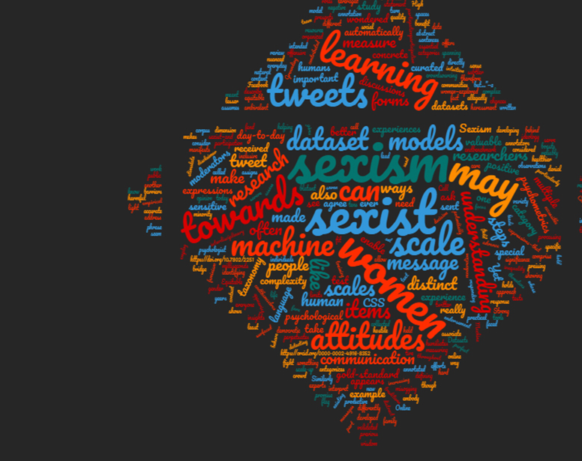
Abstract
This paper presents our approach and findings from participating in the EXIST 2023 shared task. Our work aimed to advance state of the art in online sexism detection and categorization, focusing on the three tasks: Sexism Identification, Source Intention, and Sexism Categorization. We leveraged innovative machine-learning techniques and natural language understanding methodologies to tackle this complex issue.
Keywords
https://blog.gesis.org/the-call-me-sexist-but-dataset/

Slide 24
Introduction
Introduction
Social media revolution and challenges
Background and Related Work
Progress in NLP
EXIST 2023 Tasks Overview
Sexism Identification (binary class)
Need for advanced NLP tools
EXIST 2023 competition
Challenges in sexist content detection
EXIST lab and CLEF conference
Source Intention (multi-class)
Sexism Categorization (multi-class)
Notes:
Introduction
The digital revolution brought by social media has also led to challenges such as the propagation of harmful content like hate speech, discrimination, and sexism.
There is a need for advanced Natural Language Processing (NLP) tools to comprehend the subtleties and context-dependent language often used in sexist expressions.
The EXIST 2023 competition is an initiative to enhance the understanding and detection of sexism on social media platforms.
Background and Related Work
The field of NLP has seen significant progress due to the emergence of deep learning algorithms for text classification.
However, these models often struggle with nuanced or context-dependent language, leading to misclassifications and errors.
The EXIST lab was launched as part of the CLEF conference to push the boundaries in online sexism detection and categorization.
EXIST 2023 Tasks Overview
The competition comprises three tasks: Sexism Identification, Source Intention, and Sexism Categorization.
Sexism Identification is a binary classification task, Source Intention is a categorization task, and Sexism Categorization is a multiclass task.
Dataset Description
EXIST 2023 provides a dataset of over 10,000 labeled tweets in English and Spanish.
The dataset is partitioned into training, development, and test sets.
Additional Dataset Description
In addition to the EXIST 2023 dataset, the SemEval-2023 Task 10: Explainable Detection of Online Sexism (EDOS) dataset was also utilized.
This dataset provides a rich resource for training and testing models for sexism detection.

Slide 25
Methodology
Methodology
Creating DataFrame
and Adding
Additional Data
Data Augmentation
and Label Encoding
Synonym
Replacement
Random Word
Swapping
Random Character
Insertion
Data Splitting,
Model Building, and
Training
Training
Model Architecture
Training
Adam Optimizer
Learning Rate
Scheduler
Additional English
Dataset
Label Encoding
Data Splitting
Data Splitting
Pre-train model
Dense Layers
More tools
BERT
XLM-RoBERTa
DistilBERT
3 filter
Conv 1D
Drop out
L1 generalizations
Early Stopping
Mixed Precision Training

Slide 26
Experimental Setup
Experimental Setup
System Configuration
Model Training and Validation Process
Trained models using binary cross-entropy loss and Adam optimizer
Utilized mixed-precision training policy 'mixed_float16'
Constructed models using a custom function
Results
Discussion
Visualized data distribution and label proportions
Conducted a text length analysis
Plotted loss and accuracy progress over epochs
Evaluated model on test data, generated report and confusion matrix
Interpreted results and drew conclusions
Evaluated model performance based on key metrics
Used transformers from Hugging Face and tensorflow
Set max_length of 256 for tokenization
Optimized hyperparameters via Random Search
Implemented a learning rate scheduler
Utilized early stopping based on validation loss
Validation via stratified splitting of the dataset

Slide 27
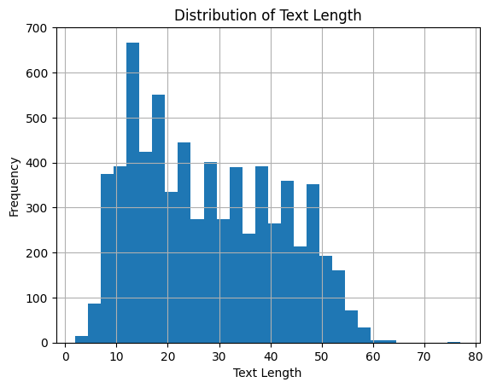
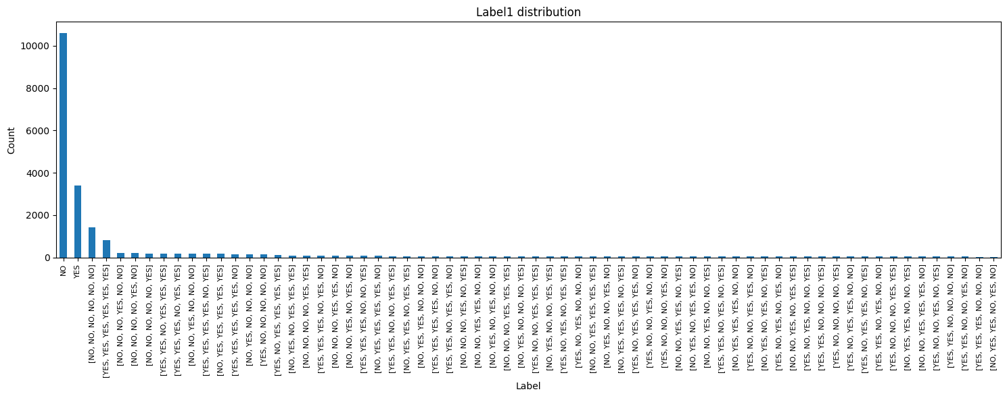
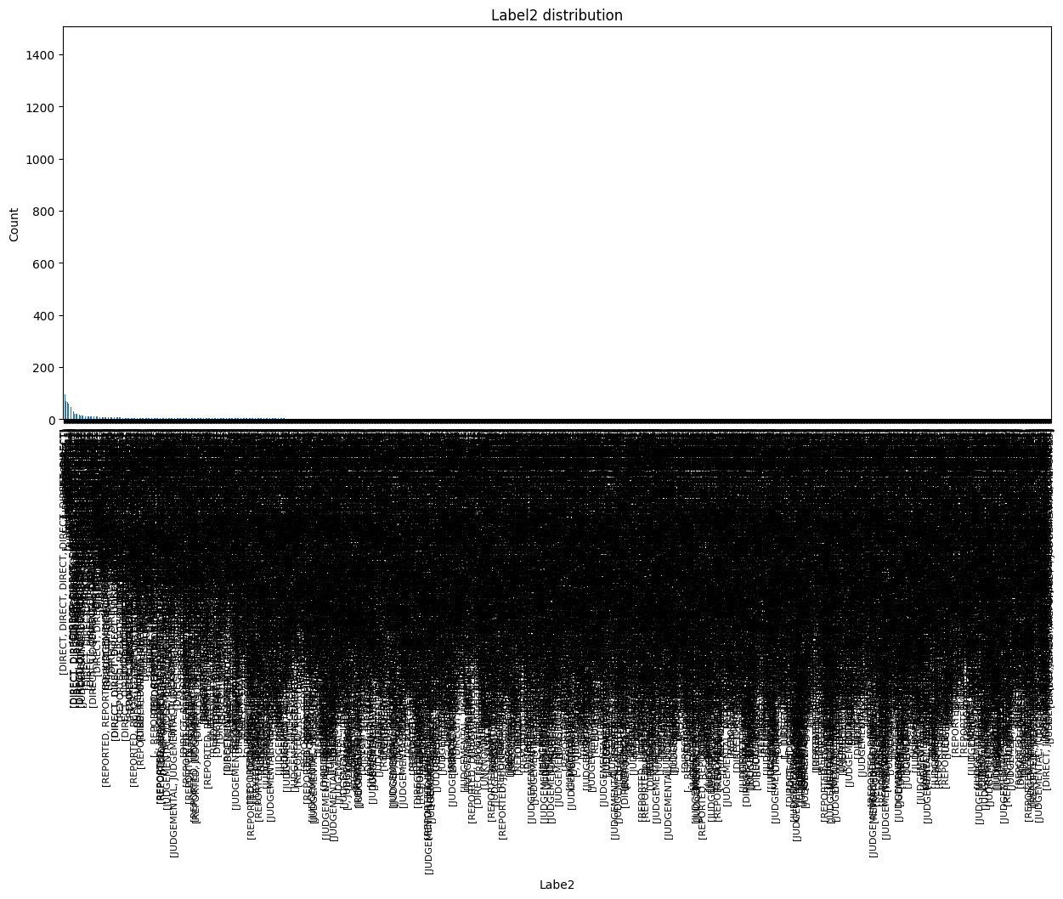
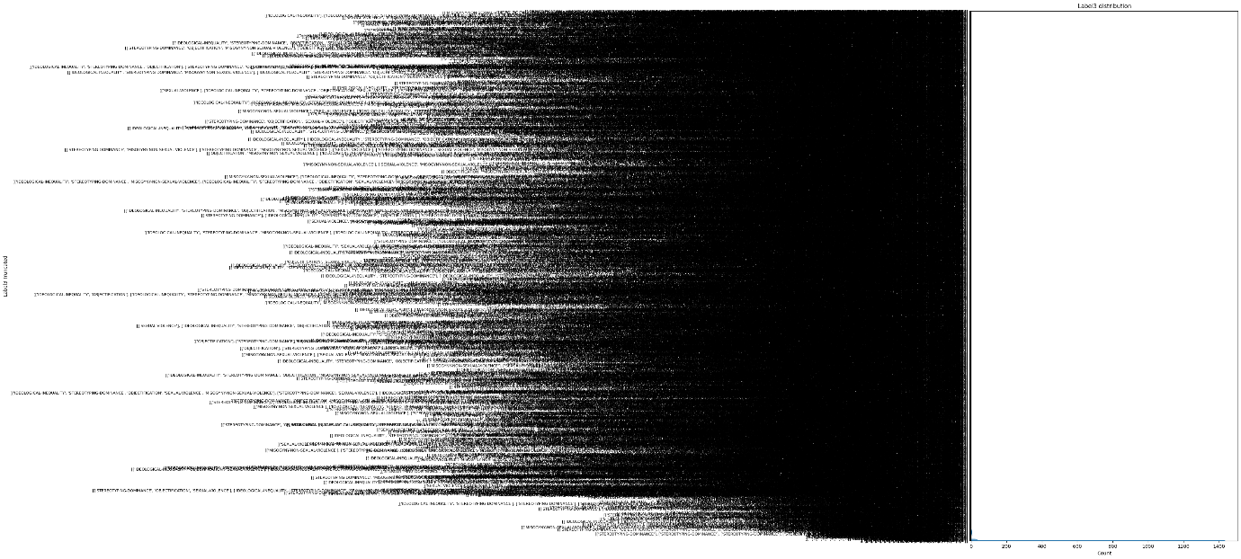
Exploratory Data Analysis (EDA)

Slide 28
Model Performance metrics for each task-run
Multi-class with Additional Dataset
Binary class with Additional Dataset

Slide 29
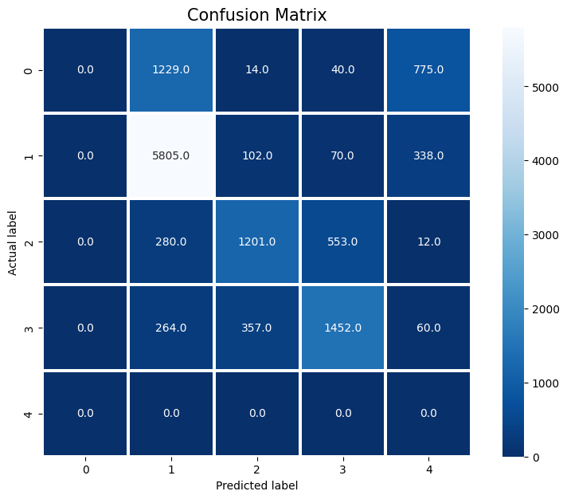
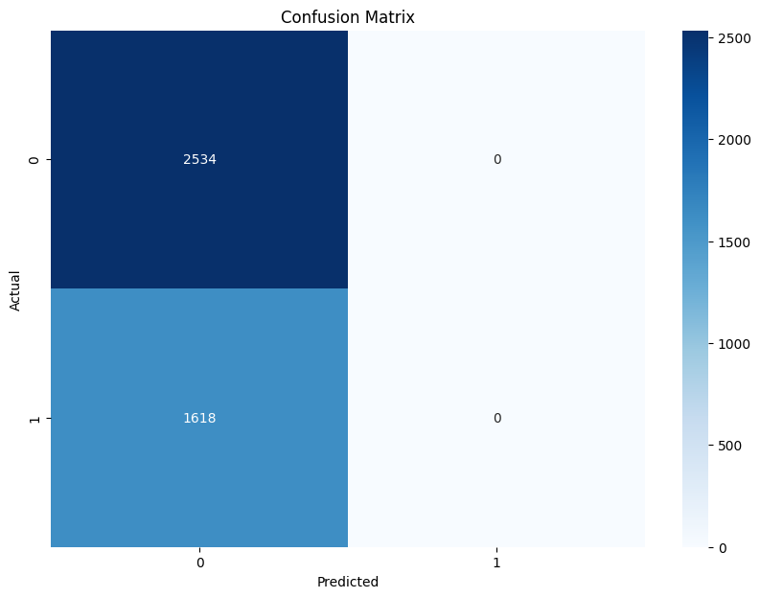
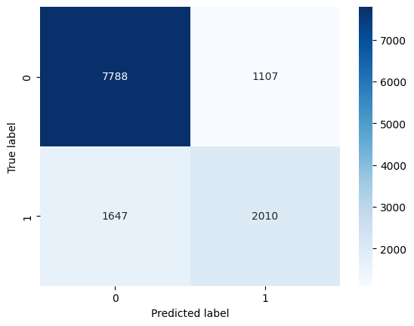
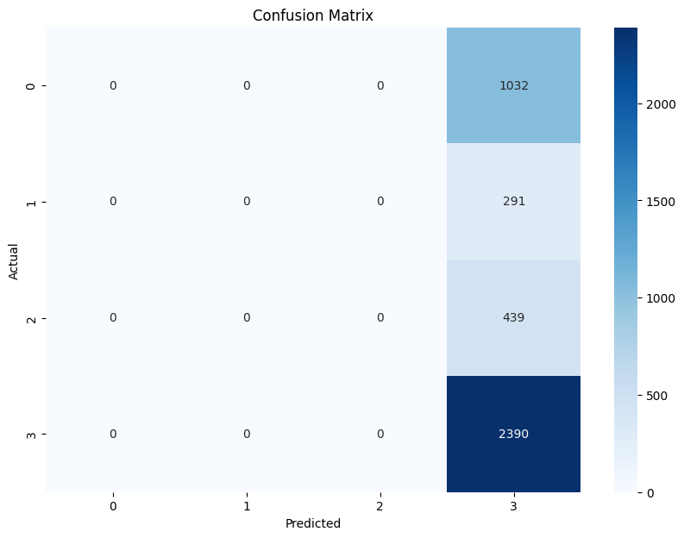
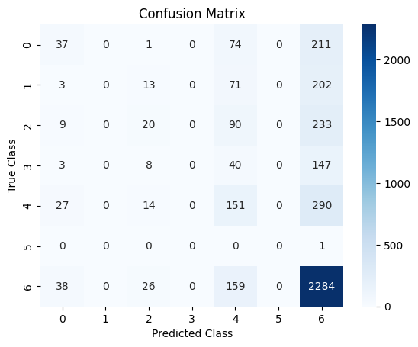
Confusion Matrix
Task 1- run 1
Task 1- run 2
Task 1- run 3
Task 2- run 1
Task 3- run 1
The Problem Of imbalance Data!!

Slide 30
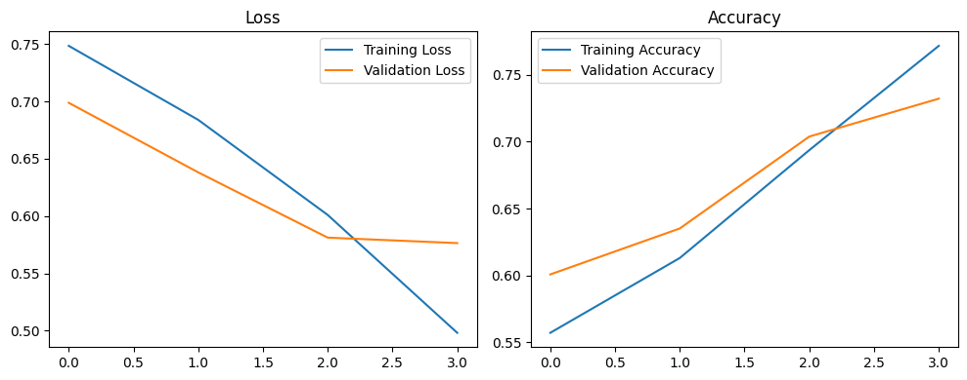
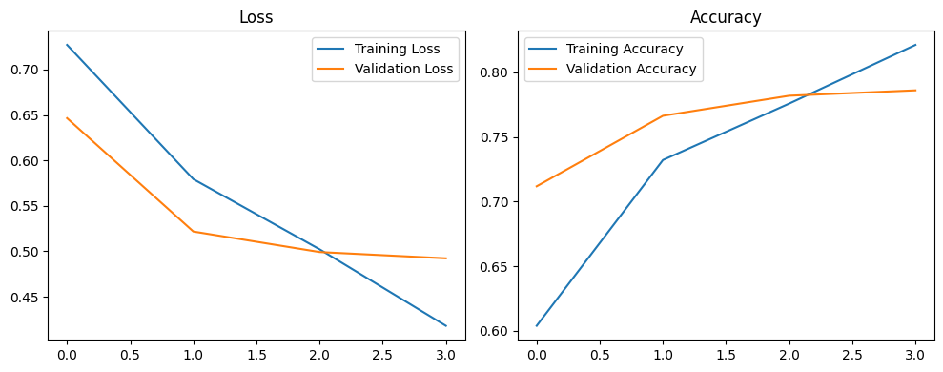
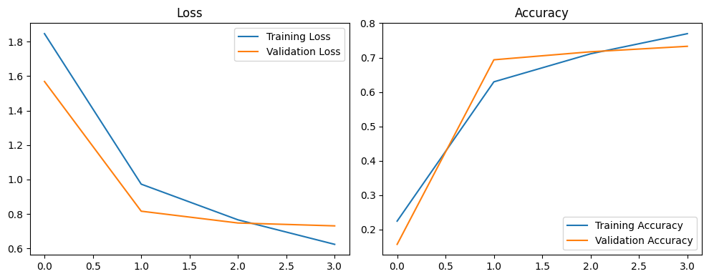
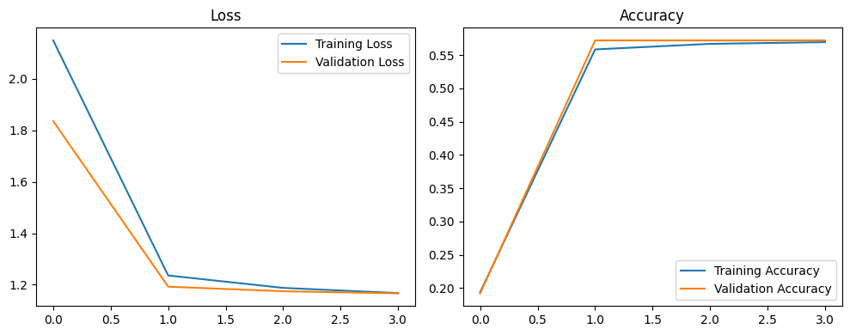
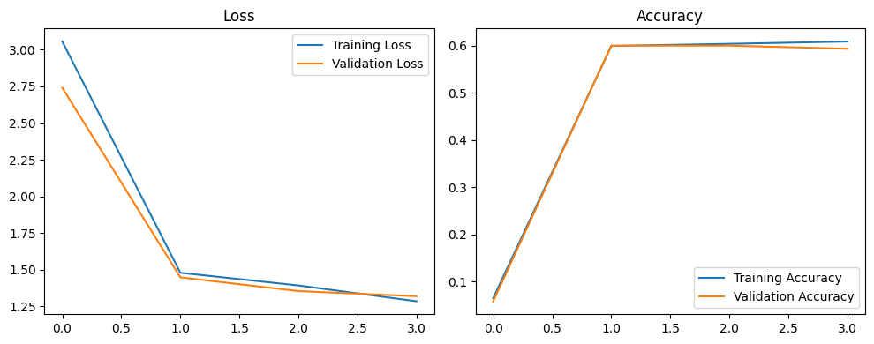
Training Performance
Task 2- run 1
Task 1- run 2
Task 1- run 3
Task 2- run 1
Task 3- run 1
Despite the use of advanced and similar pre-trained models, the use of various methods has prevented overfitting!!

Slide 31
Conclusions
Conclusions
Online Sexism Detection
Future Work
Incorporate Annotator Information
Assess Annotator Reliability
Handle Imbalanced Data
Multi-model Approach
Robust Experimental Setup
Deal with context-dependency Using XNLP technique
Test Model on Different Datasets
Effectiveness in Identifying Sexism in different source
BERT, XLM-RoBERTa, DistilBERT
Notes:
The research presents a comprehensive approach to online sexism detection using advanced machine learning techniques and natural language understanding methodologies.
A multi-model approach incorporating BERT, XLM-RoBERTa, and DistilBERT was utilized.
The methodology was evaluated through a robust experimental setup.
The results demonstrated the effectiveness of the approach in identifying and categorizing instances of sexism in online social networks.
Future work includes extending the research by incorporating additional information about the annotators, such as gender, age, and other demographic details.
The researchers plan to assess the reliability of the annotators to ensure the robustness and reliability of the dataset.
More sophisticated techniques for handling imbalanced data and dealing with subtlety and context-dependency in sexist expressions will be explored.
The researchers aim to test the model on different datasets and in different contexts to assess its generalizability.

Slide 32

Acknowledgments
This research was conducted at the Department of Methodology and Statistics, Utrecht University, Padualaan 14, 3584 CH, Utrecht, The Netherlands. We would like to express our gratitude to the faculty and staff for their continuous support and guidance throughout the course of this study. Their expertise and dedication to fostering a conducive research environment have been invaluable to our work.

Slide 33

Any Question?
Thank you
h.mohammadi@uu.nl
https://hadimohammadi.info/

